Slide 1
Neural Networks

Slide 2
What is a Neural Network
An advanced type of structure which models your brain, creating an artificial neural network that via an algorithm allows the computer to learn by incorporating new data.
They need to learn, just like a child’s developing brain, that they need to process the information. The learning strategies go by three methods as we know: Supervised, Unsupervised and Reinforcement Learning
You use NN’S in many different tasks such as Object-Recognition, Image Classification, Video Analysis, Conventional Data Science tasks.

Slide 3
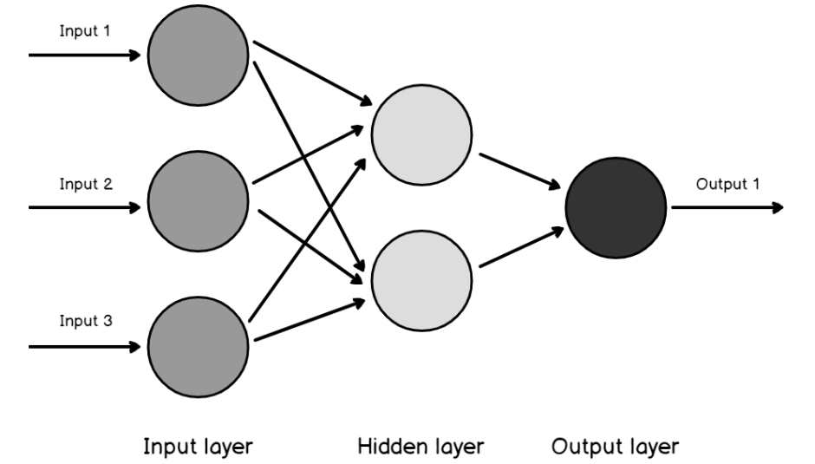
What is a Neural Network cont.
Those are the main elements in any Neural Network, keep in mind: you may have more than one hidden layer.
You take input via input layer (How do we get the information? Hearing, seeing, tasting, seeing, touching)
The taken information is analyzed to recognize the patterns in hidden layer .
Obtained results are in output layer.
We can have a large number of layers in a complex neural network.

Slide 4
Brief History of Neural Networks
Neural Networks took place in the 1970s but they have achieved huge popularity due to the recent increase in computation power because of which they are now virtually everywhere.
Warren McCulloch in 1943 introduced the single neuron with the help of electric circuits.
Frank Rosenblatt introduced The Perceptron in 1958.

Slide 5
Neuron
Axon – A small and long structure in where action potentials were created; its possible to calle as the transmitting part of a neuron. After the initation, action potentials start traveling to axons to cause the release of neurotransmitters.
Dendrite – The receiver part of a neuron. Dendrites receive synaptic inputs from axons, with the dendritic inputs controlling if the neuron is going to fire an action potential.
Spine – The small protrusions found on dendrites that are, for many synapses, the postsynaptic contact site.
Action potential is the brief electrical event that is generated in the axon whic signals the neuron as “active”. An action potential travels as the length of the axon and causes the release of neurotransmitter into the synapse. The action potential and consequent transmitter release allow the neuron to contact with other neurons as well.
Basically think of Neurons as set of functions

Slide 6
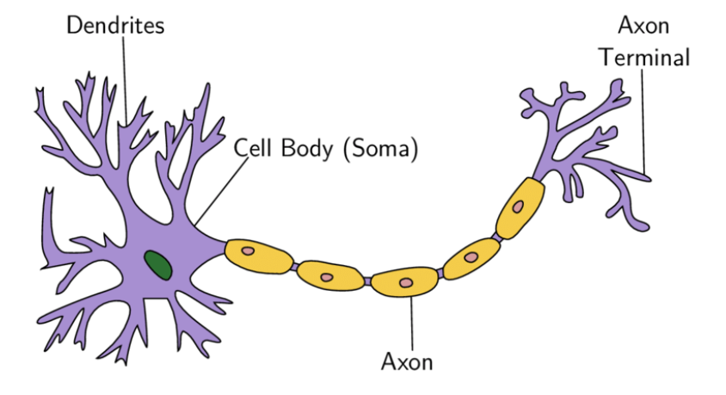
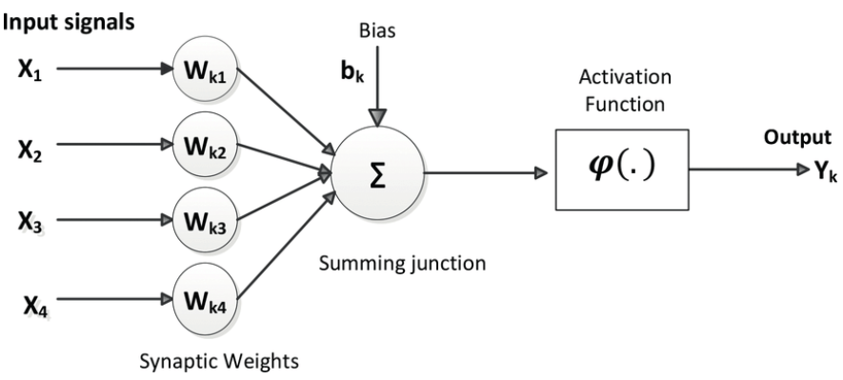

Slide 7
Definitons in Artificial Neuron
Weights: A weight represent the strength of the connection between units. If the weight from node 1 to node 2 has greater magnitude, it means that neuron 1 has greater influence over neuron 2. A weight brings down the importance of the input value. Weights near zero means changing this input will not change the output. Negative weights mean increasing this input will decrease the output. A weight decides how much influence the input will have on the output. Think of weight as input importance of a neuron.
Bias:It is an extra input to neurons and it is always 1, and has it’s own connection weight. This makes sure that even when all the inputs are none (all 0’s) there’s gonna be an activation in the neuron.
Weights and biases make neural networks self-learning algorithms.

Slide 8
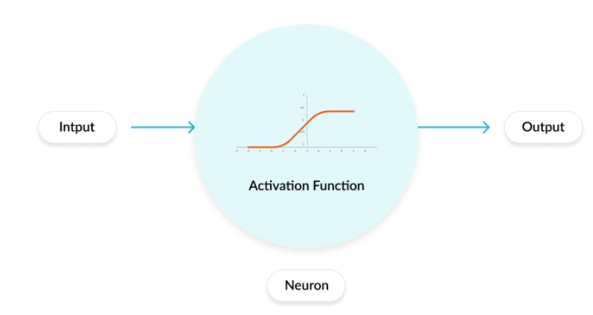
Activation Function
Activation functions are mathematical equations that determine the output of a neural network. The function is attached to each neuron in the network, and determines whether it should be activated (“fired”) or not, based on whether each neuron’s input is relevant for the model’s prediction. Activation functions also help normalize the output of each neuron to a range between 1 and 0 or between -1 and 1.

Slide 9
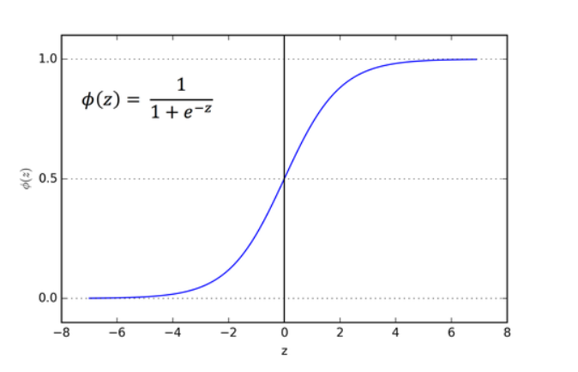
The main reason why we use sigmoid function is because it exists between (0 to 1). Therefore, it is especially used for models where we have to predict the probability as an output. Since probability of anything exists only between the range of 0 and 1, sigmoid is the right choice.
Sigmoid Function

Slide 10
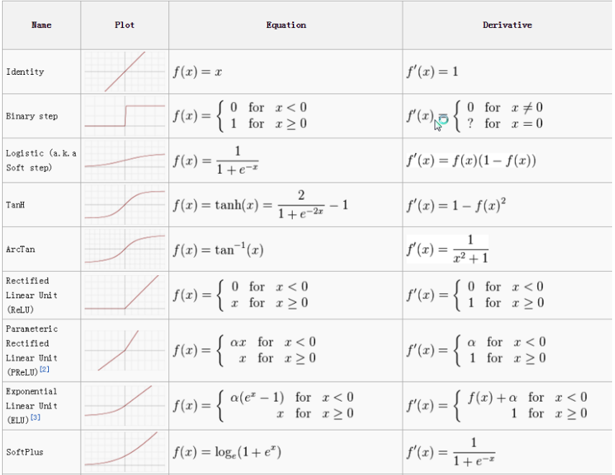
Popular Activation Functions for your NN

Slide 11
How Do Neural Networks Work?
The concept of neural network is based on three main steps:
1-For each neuron in a layer, multiply input to weight.
2-Then for each layer, sum all input x weights of neurons together.
3-Finally, apply activation function on the output to compute new output.

Slide 12
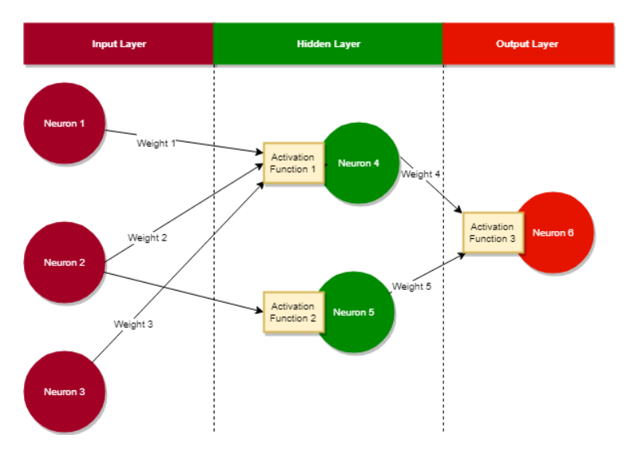

Slide 13
Each neuron has a weight associated with it. When an input enters a neuron, the weight on the neuron is multiplied to the input. For instance, weight 1 will be applied to the input of Neuron 1. If weight 1 is 0.8 and input is 1 then 0.8 will be computed from Neuron 1:
1 * 0.8 = 0.8
Sum of weight * inputs of neurons in a layer is calculated. As an example, the calculated value on the hidden layer in the image will be:
(Weight 4 x Input To Neuron 4) + (Weight 5 x Input To Neuron 5)
Finally an activation function is applied. Output calculated by the neurons becomes input to the activation function which then computes a new output. This output can flow back or to the neurons in the next layer.

Slide 14
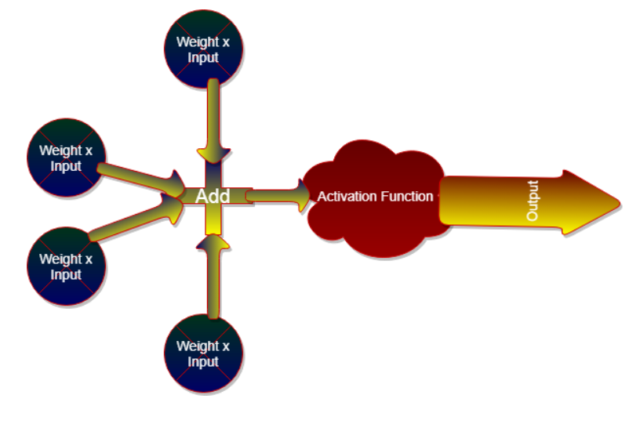
Activation functions introduce non-linearity to the neural networks which is required to solve complex problems.

Slide 15
What Is Back Propagation?
Back propagation concept helps neural networks to improve their accuracy.
Neural networks are artificially intelligent. They can learn and improve themselves.
When the actual result is different than the expected result then the weights applied to neurons are updated. Sometimes the expected and actual results are within the error threshold and neural network is considered optimal.
However occasionally, the expected output is different than the actual output. As a consequence, information is fed back into the network.. This process is recursive in nature and is known as back propagation.
Thus, back propagation makes neural networks intelligent and self-improving.

Slide 16
Types of Neural Networks
Recurrent Neural Network (RNN): RNN can work with varying lengths of input and outputs and require a large quantity of data.
Thus RNN are suitable for applications where historic information is important. These networks help us in predicting time series in trading applications and forecasting words in chat-bot applications.
Convolution Neural Network (CNN): These networks rely on convolution filters (numerical matrices). Filters are applied to the inputs before the inputs are passed to the neurons.
CNNs are useful in image processing and forecasting. T-CNN is available and it is usefull in video processing.

